Slide 1
Controller Update
F&A Meeting
May 9, 2023

Slide 2
FY 2023 Year End Close Memo
Distributed tomorrow
Dates are consistent with prior years
Pay close attention to these deadlines
  Missing processing deadlines could result in charges against FY 2024 budgets
Vendor invoice accrual process
  Same criteria as prior year
Travel reimbursement accrual based on travel date

Slide 3
Vendor Invoice Accrual Criteria
Vendor Commitments | FY 2023
Accrual Period | 7/1/23-8/11/23
JE Frequency | Every Other Week
Invoices Reviewed | Selected Commodities
Invoice Threshold | $1,000
Commodity Codes
Advertising |  | Business Meetings/Conferences
Construction/Renovation, includes CFS |  | Consulting Services, includes CFS
Consulting Services, Information Technology, includes CFS |  | Equipment - Information Technology (All)
Equipment - Law Enforcement |  | Equipment - Medical
Equipment Capital (Excludes Information Technology) |  | Equipment Maintenance and Repair
Equipment Non-Capital (Excludes Information Technology) |  | Fees/Licenses/Permits (Excluding IT software)
Insurance |  | IT software/licenses/upgrades
Lease/Rental - Space or Property |  | Lease/Rental Equipment - Information Technology
Lease/Rental Equipment (Excludes Information Technology) |  | Mailings
Moving Services |  | Operational Services, includes CFS
Rental Event Equipment |  | SubAward/SubContract
Utilities

Slide 4
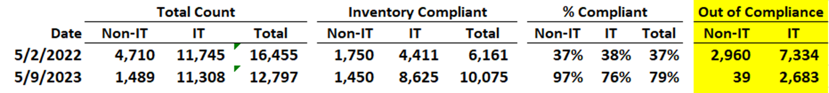
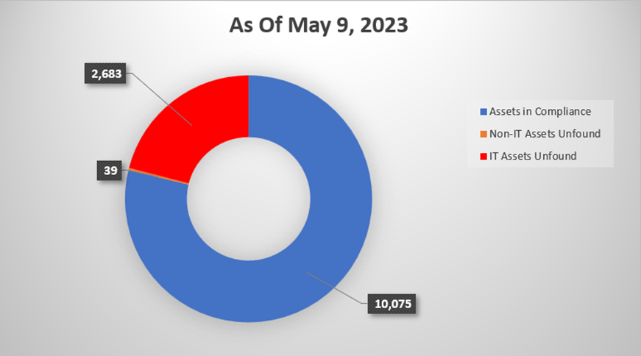
Physical Inventory Update
IT Recycling Events
May 10 McCormack
May 17 Campus Center
May 31 Quinn
June 7 Healey
June 14 ISC
June 21 Clark

