Slide 1

APPROP Budget Model FY23

Slide 2
APPROP vs ORG Budget Model
The ORG budget model could be viewed as the “traditional” budget model, this is the model used in general funds (GOF, State, Tuition), expenses are budgeted at the UM-Plan subsidiary (account grouping) level and systemically these budgets are not directly tied to revenue.
The APPROP budget model is a revenue-based budget model. In this budget model spending authorization is increased as revenue is recognized, carry-forward expenses require a budget load. Any budget load for carry-forward, if necessary, is loaded at the “all expense” level and would not be loaded at the lower-level UM-Plan subsidiary (account grouping) level.
Summit: ORG budgets are managed in the Activity tab of the Department Management dashboard under the section “Budget Balance Activity”, conversely APPROP budgets are managed under the section “Fund Balance Activity” (more on this in subsequent slides).
Historical confusion: There may be some confusion generated by this topic because on the Boston campus in recent memory we changed the budget model of many “Revenue Based” funds to the ORG budget model. While we refer to the funds as “Revenue Based” we still manage them in the system as ORG budgets. This presentation will clearly communicate which funds are in the APPROP model in FY23.

Slide 3
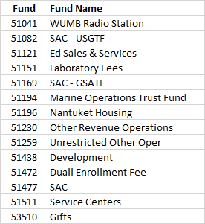
FY23 APPROP Model Funds
The following Funds use the APPROP model in FY23:
NOTE: Some chartfields in these funds were originally designed as “revenue only” chartfields, in these chartfield expenses will result in a budget error.

Slide 4
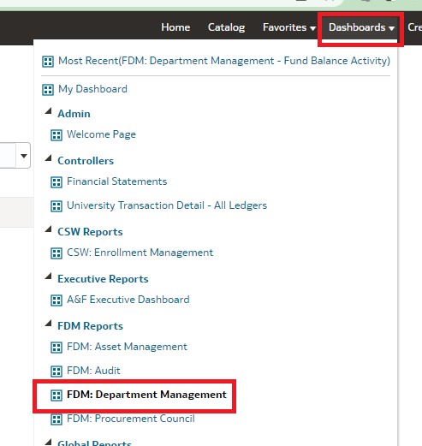
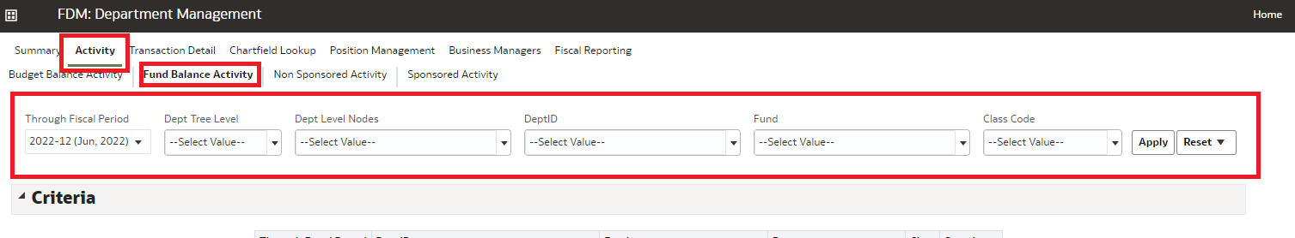
APPROP Budget Model in Summit - Navigation
Navigate to the “FDM: Department Management” Dashboard (left)
Select the “Activity” tab, “Fund Balance Activity” section, & use the drop downs to change the criteria, then hit apply (below)

Slide 5
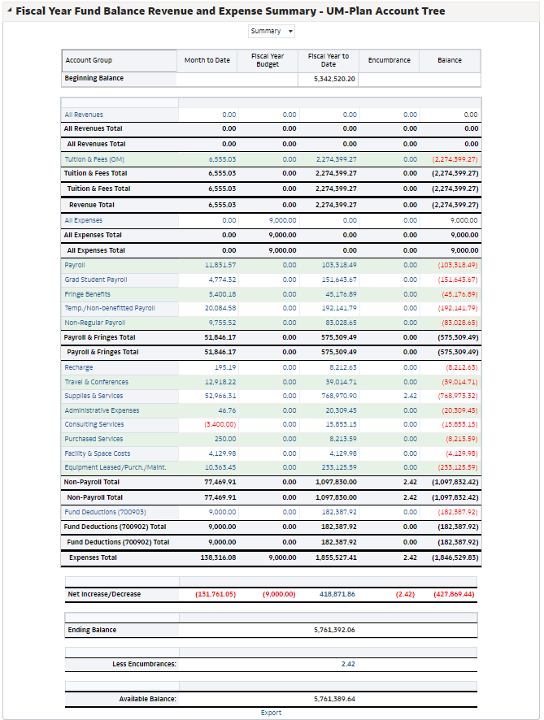
APPROP Budget Model in Summit - Output
This is an example of the output summary from Summit. This dashboard can be confusing so the subsequent slides will point out the key items to look for in managing APPROP model funds in this dashboard summary.
The available balance shows your spending limit based upon your carry-forward balance and current revenues.
If you expect to spend more than your current revenues during the fiscal year, please reach out to OBFP and/or the Provost Office.
NOTE: Some chartfields in these funds were originally designed as “revenue only” chartfields, and although they will appear in SUMMIT, expenses will result in a budget error.

Slide 6
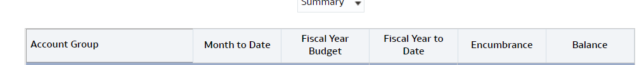
APPROP Budget Model in Summit – Columns
Account Group – Description/Grouping of the financial information
Month to Date – Activity to date in the month selected based on the initial criteria selection
Fiscal Year Budget – Fiscal year budget, in these funds you will only see budgeted loaded in the “All Expense” Account Group section and it will only be representative of carry-forward
Fiscal Year to Date – Activity to date in the year selected based on the initial criteria selection
Encumbrances – Open payroll and AP commitments
Balance – Budget remaining balance, this column can be confusing in the Fund Balance Activity Summary because budgets are only loaded for carry-forward. There is only one number in this column that is useful for managing fund activity (discussed in a subsequent slide).

Slide 7
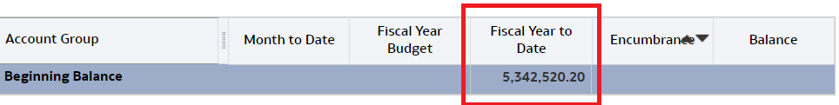
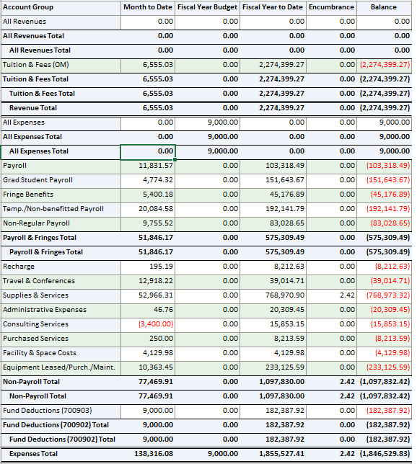
APPROP Budget Model in Summit – Key Information
The first row is the “Beginning Balance” account group, in the “Fiscal Year to Date” column is the amount of carry-forward at the start of the selected fiscal year based on initial criteria.
The next major section you will see a detail of all revenue and expense categories in each column, in this section the balance column is not informative.

Slide 8
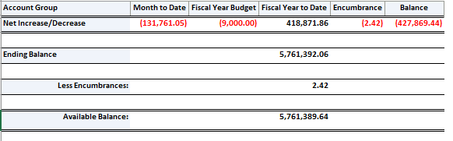
APPROP Budget Model in Summit – Key Information
The bottom section of the report contains the summarizing information to help manage these funds:
Net Increase/Decrease – This row shows in each column the net of revenue minus expense, the most useful column is “Fiscal Year to Date”, in this column you can see how much the fund balance (AKA carry-forward) has increased or (decreased) year-to-date based on the initial selection criteria. The other column that is useful is the “Balance” column, as stated previously this is the only row where the balance column is useful, in this column a (negative) balance shows the inverse of current fiscal year funds remaining available (revenue generated and carry-forward budget loaded vs. expense), the number is inverse because of the drawbacks of the way this column is calculated, intuitively a balance remaining should be positive, however it still can be used to garner valuable information when you reverse the signage.
Ending Balance – This row will only have the “Fiscal Year to Date” column populated and it shows the current carry-forward balance based on year-to-date activity before encumbrances.
Available Balance – This row is similar to “Ending Balance”, however it shows the anticipated carry-forward balance after encumbrances.

Slide 9
APPROP Budget Model FAQ
Q: Does this change the carry-forward usage policy?
  A: No, the guidance around carry-forward remains the same: Carry-Forward usage is permitted to fund Capital and Start-Up projects, but all other uses need to be requested and approved by OBFP and/or Provost office
Q: Does this change the requirements for planning these funds in the UM-Plan budget process?
  A: No, these funds will still need to be planned in detail in the department budget planning files. In the budget process budget planning files roll up to the Campus-Wide income statement projection, so just because spending authorization in PeopleSoft is automatically increased with revenue recognition and there is only a need to load carry-forward budgets, we still need detailed planning to properly roll up our income statement in UM-Plan
Q: What if up-front expenses are needed prior to revenue generation in a given fiscal year?
  A: These funds are allowed to be spent from at the start of the year prior to revenue generation with this in mind, OBFP is aware that revenue may not be generated until after some expense. OBFP will monitor these funds, as always, and reach out to areas on an individual basis to mitigate risks of overspending revenue and approved carry-forward for the full fiscal year, but the intent is to not limit spending due to timing of revenue generation.

