Slide 1
Unified Procurement Services Team (UPST)
Boston F&A Meeting
  February 14, 2023

Slide 2
Agenda
Supplier Onboarding & Self-Service Processes Update (A. Zuev)
Invoice Approval Workflow Project (L. Ferrell)
Airgas Catalog Implementation (K. McCauley)

Slide 3
Supplier Onboarding & Self-Service Processes

Slide 4
Overview & Objective
Supplier set-up process is the one process that you, our stakeholders, have provided the most feedback on the impact of its inefficiency on your daily operations.
The new Supplier Onboarding & Self-Service process and form aims to solve this while also moving direct supplier follow-up activities to UPST.
The main objectives of this new process includes:
Improve campus/supplier user experience
Reduce supplier request processing cycle time
Streamline supplier process by putting UPST immediately after submission to drive end-to-end process
One intake form for all supplier types (domestic individual , entities, foreign, employees, and students)
Improved efficiency i.e., limit errors, duplicates and manage request volume
Increase visibility on supplier set-up status and usage - supplier dashboard
DRAFT-CONFIDENTIAL

Slide 5
Process Change Explained
Previous: No vetting / Campuses send direct invitation
2X-3X
Supplier
UPST
Review, cleanup, delete duplicate record, proxy to correct record, etc.
Department
Supplier
UPST
Department
Invites Supplier
Portal Registration
Approve Supplier Record
Invites Supplier
2X-3X
New: Supplier Request Form
Department
UPST
Supplier
UPST
Review request, proxy, and/or approve supplier record or send invitation
Approve Supplier Record
Completes Supplier Request Form
Portal Registration
DRAFT-CONFIDENTIAL

Slide 6
Onboarding Channel for all Suppliers
Supplier Type | New Request / Reactivate | Update Information | Comments
Domestic Individual | BuyWays | BuyWays
Student | BuyWays | BuyWays | Review the Student Decision Tool before creating a request.
Employee | BuyWays | BuyWays | Complete the ‘Determination of Independent Contractor Status’ form and discuss with your campus HR before requesting
Entity (Corporations, LLC, LPP) | BuyWays | BuyWays
Foreign Supplier | BuyWays | BuyWays | Supplier may be required to go through Glacier for tax purposes

Slide 7
Request Form Launch Dates
February 13th
Boston, Dartmouth, President’s Office
February 27th
Lowell & UMass Chan
March 13th
Amherst
7

Slide 8
Training Sessions
February
Thursday, February 9, 2023; 11:00 am - 12:00 pm
Tuesday, February 14, 2023; 2:00 pm - 3:00 pm
Thursday, February 23, 2023; 9:00 am - 10:00 am
Tuesday, February 28, 2023; 2:00 pm - 3:00 pm
Register Here
March
Tuesday, March 7, 2023; 10:00 am - 11:00 am
Thursday, March 9, 2023; 1:00 pm - 2:00 pm
Tuesday, March 14, 2023; 11:00 am - 12:00 pm
Thursday, March 16, 2023; 1:00 pm - 2:00 pm
Monday, March 20, 2023; 10:00 am - 11:00 am
Wednesday, March 22, 2023; 2:00 pm - 3:00 pm
Register Here
Always visit project website for the most updated information

Slide 9
Invoice Approval Workflow Project
(Re-start)

Slide 10
What is the BuyWays Invoice Approval Workflow?
Invoice Approval Workflow is integrated in BuyWays enabling departments to approve invoices electronically and eliminate manual invoice submission.
Approval confirms goods or services were provided and in compliance with the Purchase Order.
Invoices are entered at the front of the process, rather than the end.

Slide 11
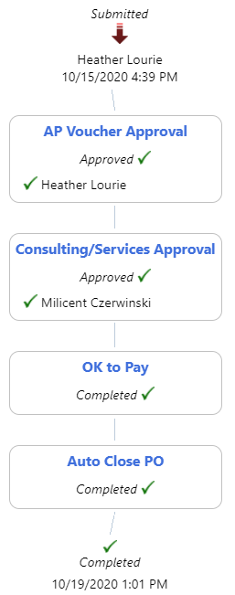
BuyWays Invoice Approval Benefits
Promotes efficiency
Ensures greater invoice visibility and control by the departments
Supports UMass “go green” initiatives by being less paper intensive
Provides added functionality and allow for more automation in the Accounts Payable process in the future

Slide 12
Available Workflow Options
Departments may select one or more of the following workflow approval steps available in BuyWays:
PO Owner-When invoices are entered by Accounts Payable they become assigned to the person who is the PO Owner on the PO.
Consulting/Services -Lists a group of approvers that need the invoice approval “pooled” with two or more approvers. Some departments have used this step to split their department ID’s among a few approvers.
Department Approver– This workflow step lists the Department Approver for invoice workflow. This is the same person who has department approval for requisitions.
Fund Approval-Originally created for grants, this approval step is intended to be the same approval that is set up for Fund Code approval on requisitions

Slide 13
Next Steps
Send an email today to upst@umassp.edu
Subject: Invoice Approval Workflow!

Slide 14
Airgas Catalog Implementation

Slide 15

UMass / Airgas Catalog Implementation
UMass discounted Contract Pricing assurance
Streamlined ordering process, stored favorites for easy reordering
Elimination of additional charges/surcharges to departments
Electronic orders and billing to improve accuracy, compliance and timeliness
Confirmation on orders and delivery
Transparency into on-site cylinders
  Reduction of lost cylinder cost/negotiations
Eliminate discrepancies in AirGas deliveries and charges that currently occur between the campus and supplier
Transparency on what the University and departments consume to improve negotiation leverage
DRAFT-CONFIDENTIAL
15

Slide 16
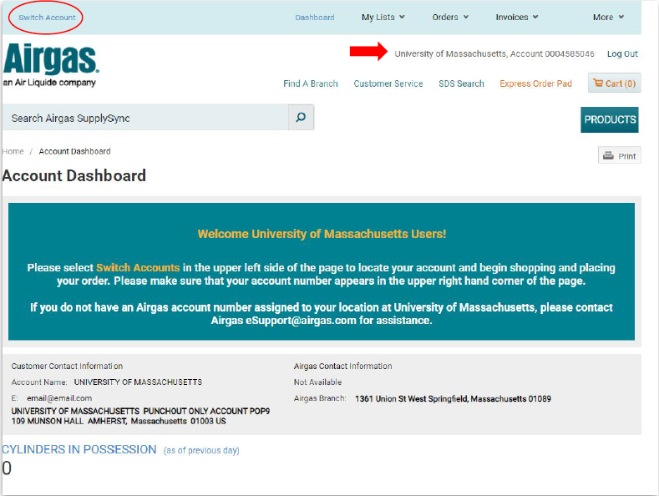
UMass / Airgas Catalog Implementation
Once a default address is saved, the punchout will open to users preferred account
Users favorites and previous orders will be accessible and replacement or regular fulfilment orders are only a click away
UMass contract pricing and discounts will be preloaded
Open cylinder balance is clearly marked on users account page
DRAFT-CONFIDENTIAL
16

Slide 17
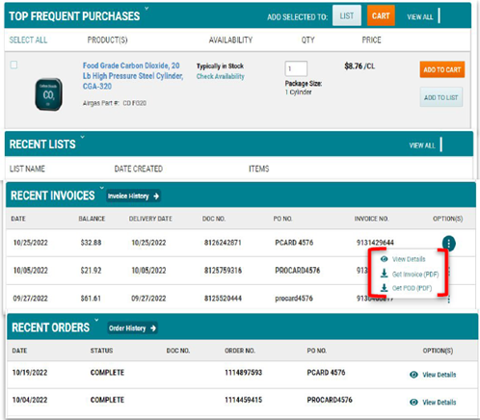
UMass / Airgas Catalog Implementation
Easy reorder process makes the buying simple for the user with stored favorites
User has full access into account and purchase details & history
  Order history
  Delivery date
  Proof of delivery
  Invoice history
  Payment details
  Account balance
  Cylinder balance

